Slide 1
Ruby- Web Development Project
“MAP MY LIFE”
Hannah

Slide 2
Brief
Travel Bucket List
Build an app to track someone's travel adventures.
MVP:
The app should allow the user to track countries and cities they want to visit and those they have visited.
The user should be able to create, edit and delete countries
Each country should have one or more cities to visit
The user should be able to create, edit and delete cities
The app should allow the user to mark destinations as visited or still to see
Possible Extensions:
Have separate pages for destinations visited and those still to visit
Add sights to the destination cities
Search for destination by continent, city or country
Any other ideas you might come up with

Slide 3
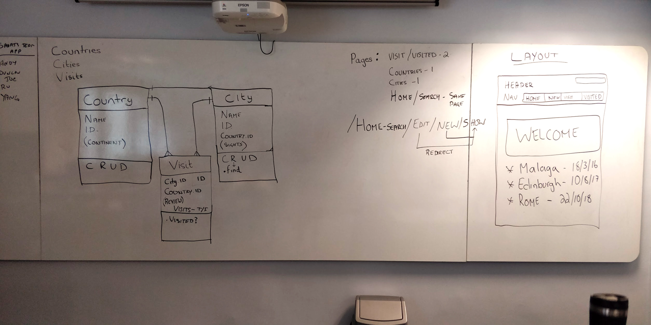
Group Planning

Slide 4
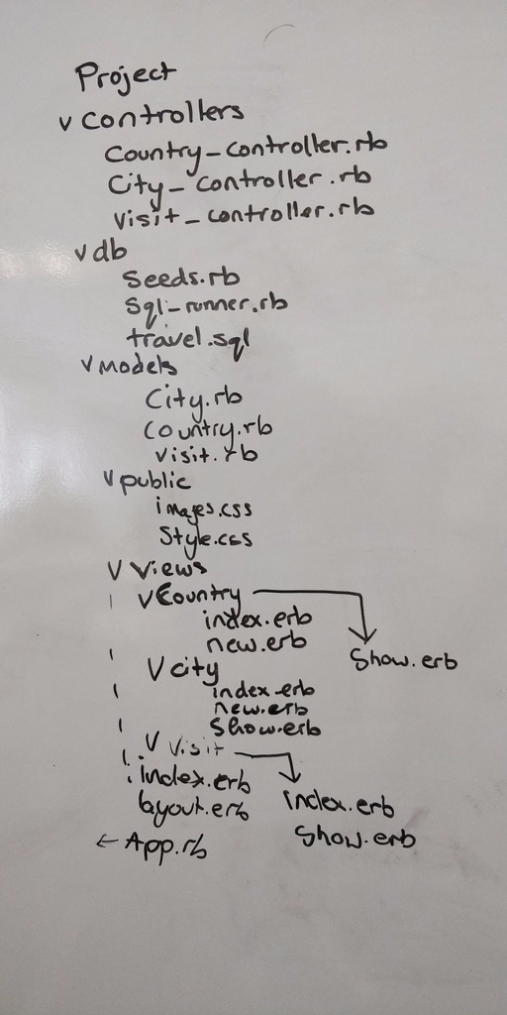
Possible project filenames:

Slide 5
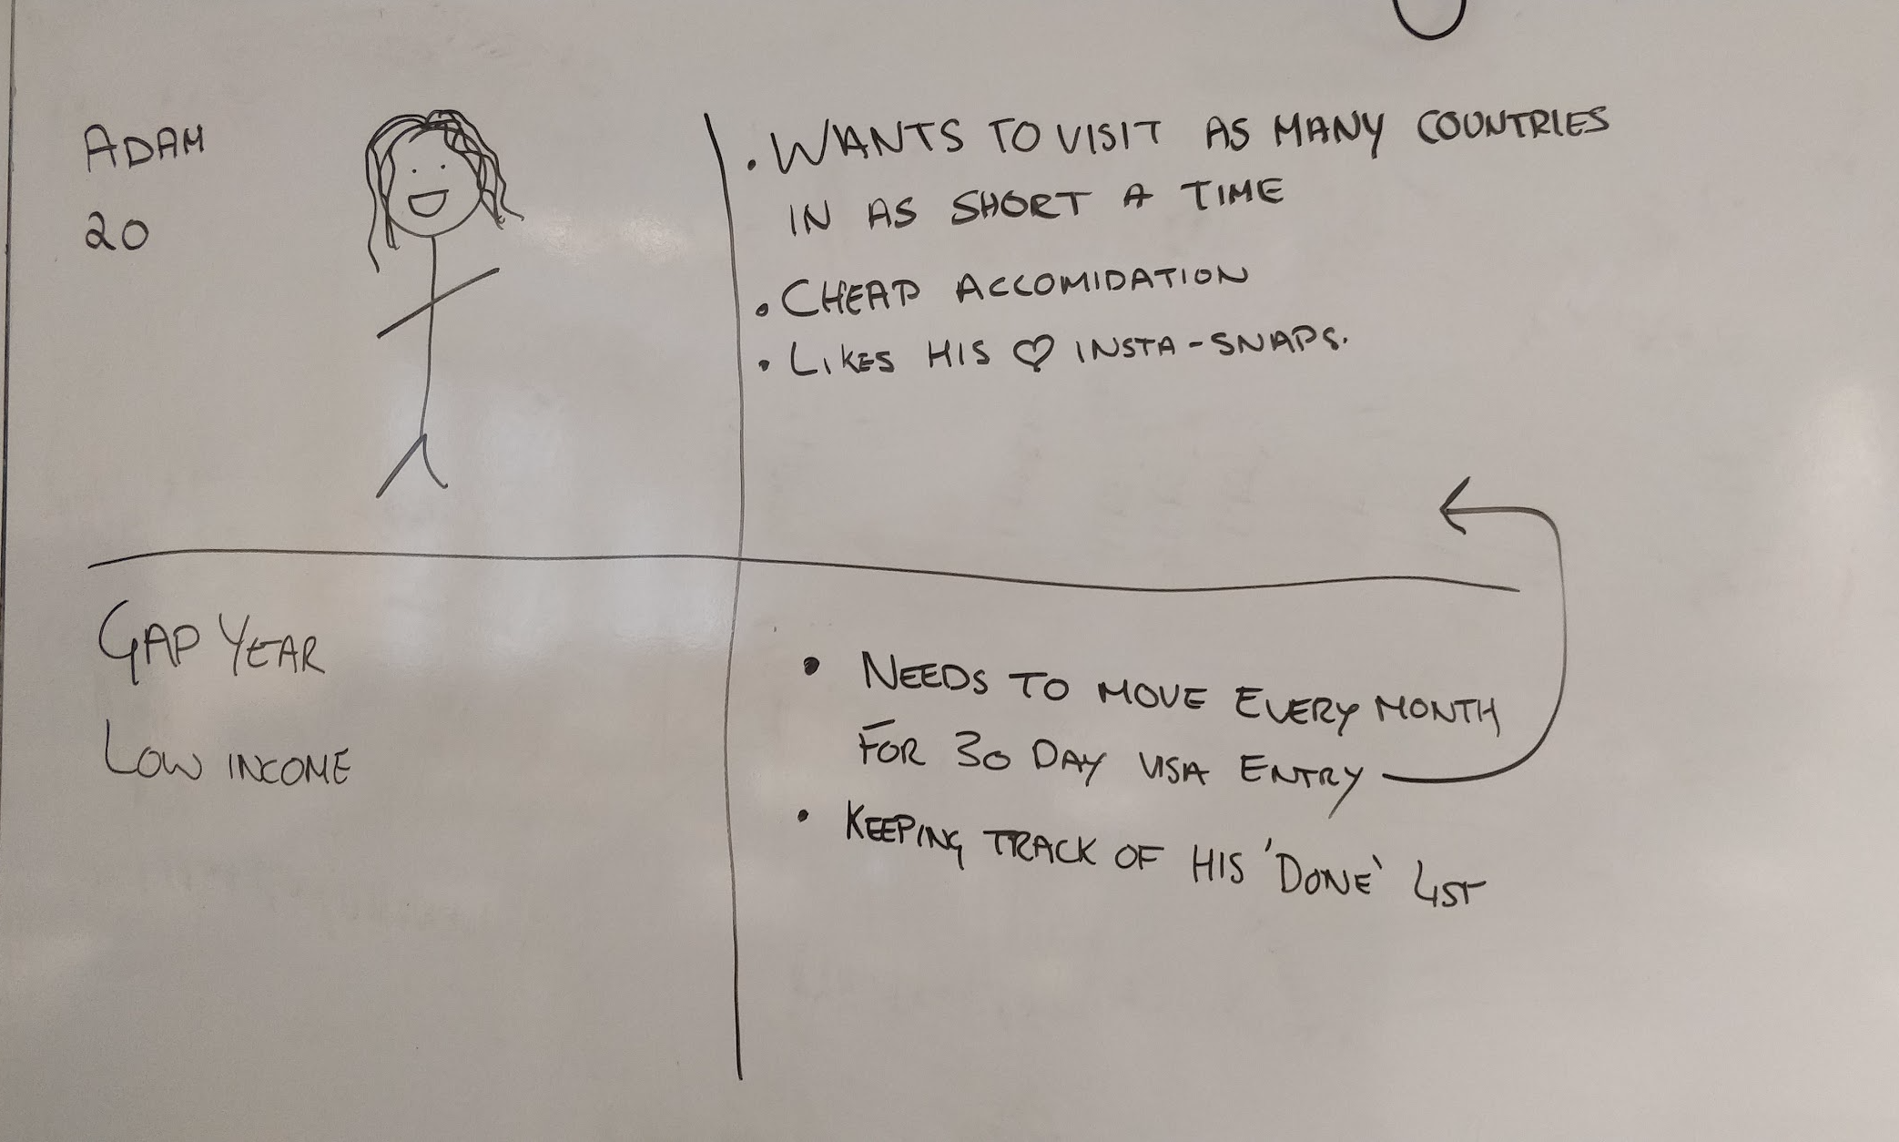
Group UX

Slide 6
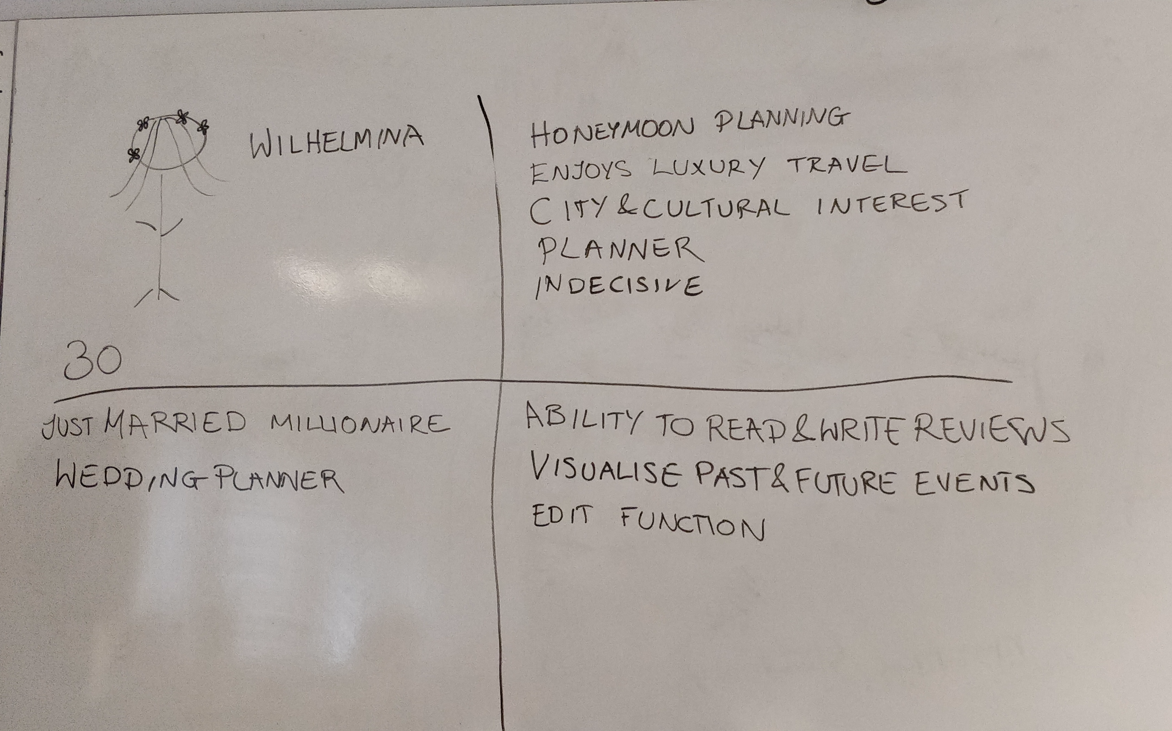
Group UX

Slide 7
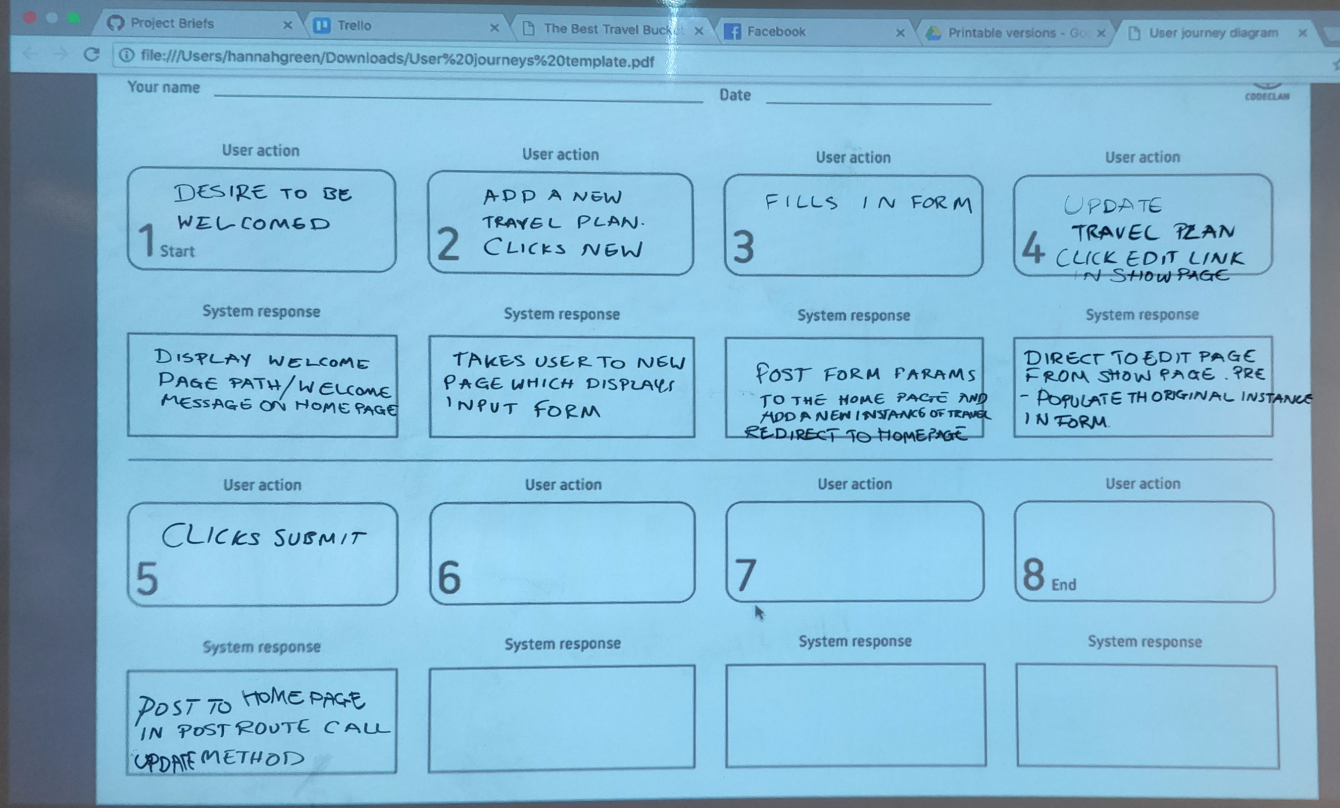
Group UX

Slide 8
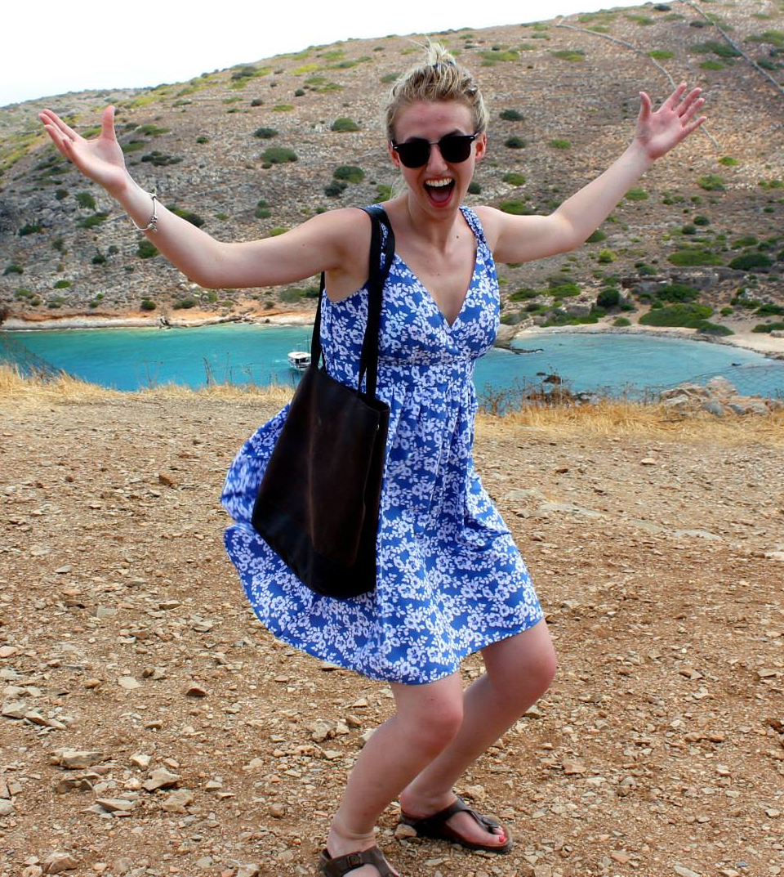
UX- Proto Personas
Emma
25
Lives in London
Married
Loves to travel to new places
Needs to be organised and have an itinerary
Sometimes organises for larger groups

Slide 9
UX

Slide 10
UX

Slide 11
Wire frames

